Slide 1
Greedy Method
Unit 4

Slide 2
Greedy Method
A greedy algorithm is a mathematical process that looks for simple, easy-to-implement solutions to complex, multi-step problems by deciding which next step will provide the most obvious benefit.

Slide 3
Why they are greedy ?
Such algorithms are called greedy because while the optimal solution to each smaller instance will provide an immediate output
The algorithm doesn’t consider the larger problem as a whole.
Once a decision has been made, it is never reconsidered.
The greedy choice property brings efficiency in solving the problem with the help of subproblems.

Slide 4
How it works ?
It work by recursively constructing a set of objects from the smallest possible constituent parts.
It works in stages.
Selects some solution from input domain.
Only one input is considered at each time.
Checks whether the solution is feasible or not.
From the set of feasible solutions selects optimal solutions.

Slide 5
Advantage of greedy method
solutions to smaller instances of the problem can be straightforward and easy to understand.

Slide 6
Where will u apply?
Greedy algorithms are often used in ad hoc mobile networking to efficiently route packets with the fewest number of hops and the shortest delay possible.
They are also used in machine learning (ML), business intelligence (BI), artificial intelligence (AI) and programming.

Slide 7
Various other applications
Job sequencing with deadline
Knapsack problem
Minimum spanning tree
Single source shortest path
Optimal merge pattern
Container loading

Slide 8
Comparison
Divide and conquer
Greedy method
Used to obtain solution to a given problem
Problem is divided into sub problems
Duplications in subsolutions are neglected.
Examples: quick sort, binary search
Used to obtain optimum solution
Optimum solution is picked up from a set of feasible solutions.
Optimum selection is without revising the previously generated solutions.
Examples: Knapsack problem.

Slide 9
Some greedy methods
With examples

Slide 10
Job sequencing with deadlines -1
Number of jobs- N
Profit after completing the job before deadline
Time to complete the job (deadline)
Time complexity is O(n²)
Rules:
Each job takes one unit of time
Job should be completed to get profit
Goal is to schedule jobs to maximize the total profit
Conceder all possible schedules and compute the total
N | Pi | Di
1 | 70 | 2
2 | 12 | 1
3 | 18 | 2
4 | 35 | 1

Slide 11
Example cont..
The feasible solutions are:
N | Pi
1 | 70
2 | 12
3 | 18
4 | 35
1,2 | 82*
2,1 | 82
1,3 | 88
3,1 | 88
1,4 | 105*
4,1 | 105
2,3 | 30
3,2 | 30*
2,4 | 47*
4,2 | 47*
3,4 | 53*
4,3 | 53
N | Pi | Di
1 | 70 | 2
2 | 12 | 1
3 | 18 | 2
4 | 35 | 1
N | Pi
1 | 70
2 | 12
3 | 18
4 | 35
1,3 | 88
2,1 | 82
2,3 | 30
3,1 | 88
4,1 | 105
4,3 | 53
0 1 2 3 4 5
Time line
optimum
* job Sequence not allowed

Slide 12
Exercise -1
Find the optimum schedule for the following jobs with n = 7.
N | Pi | Di
A | 41 | 3
B | 36 | 2
C | 52 | 4
D | 89 | 2
E | 47 | 1
F | 22 | 3
G | 22 | 2

Slide 13
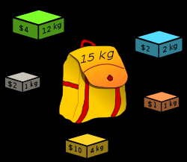
Knapsack problem - 2
The knapsack problem or rucksack problem is a problem in combinatorial optimization.
Given some items
pack the knapsack to get the maximum total value.
Each item has some weight and some value.
Total weight that we can carry is no more than some fixed number W.
So we must consider weights of items as well as their values.
Item # Weight Value
1 1 8
2 3 6
3 5 5

Slide 14
Knapsack problem
There are two versions of the problem:
“0-1 knapsack problem”
Items are indivisible;
you either take an item or not.
Some special instances can be solved with dynamic programming
“Fractional knapsack problem”
Items are divisible: you can take any fraction of an item
Time complexity is O(n)

Slide 15
0-1 Knapsack problem
Given a knapsack with maximum capacity W, and a set S consisting of n items
Each item i has some weight w_{i} and benefit value b_{i} (all w_{i} and W are integer values)
Problem: How to pack the knapsack to achieve maximum total value of packed items?
The problem is called a “0-1” problem, because each item must be entirely accepted or rejected.

Slide 16
Fractional Knapsack problem
Choose only those objects that give maximum profit.
The total weight of selected items <= W
Generate set of feasible solutions
Sum of p_{i} x_{i} subject to sum of w_{i} x_{i} <= W

Slide 17
Exercise -2
Find the optimal solution of the 0-1 Knapsack instance W = 10;
I | Wi | Pi
1 | 2 | 5
2 | 3 | 3
3 | 6 | 7
4 | 7 | 1

Slide 18
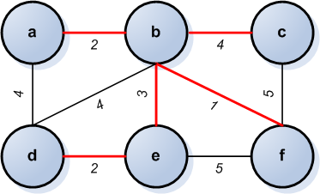
Minimum cost spanning tree-3
Spanning tree: is a sub graph of a graph which is a tree and it contains all the vertices of the graph with no circuits.

Slide 19
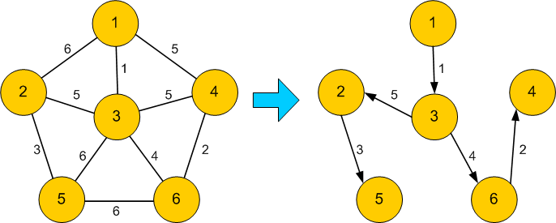
Minimum spanning tree
Minimum spanning tree: a min spanning tree of a waited connected graph is a spanning tree with minimum or smallest weight.

Slide 20
Applications of spanning tree
Weight of the graph: the sum of weights of all its edges.
Used in designing efficient routing algorithms
Network design

Slide 21
Minimum Connector Algorithms
Kruskal’s algorithm
Select the shortest edge in a network
Select the next shortest edge which does not create a cycle
Repeat step 2 until all vertices have been connected
Time complexity is O(ElogV)
E – total number of edges
V- total number of vertices
Prim’s algorithm
Select any vertex
Select the shortest edge connected to that vertex
Select the shortest edge connected to any vertex already connected
Repeat step 3 until all vertices have been connected
Time complexity is O(v²)

Slide 22
A cable company want to connect five villages to their network which currently extends to the market town of A. What is the minimum length of cable needed?
Example
B
5
C
3
4
8
6
8
A
F
D
7
5
4
2
E

Slide 23
Kruskal’s Algorithm
List the edges in order of size:
ED 2
AB 3
AE 4
CD 4
BC 5
EF 5
CF 6
AF 7
BF 8
CF 8
B
5
C
3
4
8
6
8
A
D
7
F
5
4
2
E

Slide 24
Kruskal’s Algorithm
Select the shortest
edge in the network
ED 2
B
5
C
3
4
8
6
8
A
D
7
F
5
4
2
E

Slide 25
Kruskal’s Algorithm
Select the next shortest
edge which does not
create a cycle
ED 2
AB 3
B
5
C
3
4
8
6
8
A
D
7
F
5
4
2
E

Slide 26
Kruskal’s Algorithm
Select the next shortest
edge which does not
create a cycle
ED 2
AB 3
CD 4 (or AE 4)
B
5
C
3
4
8
6
8
A
D
7
F
5
4
2
E

Slide 27
Kruskal’s Algorithm
Select the next shortest
edge which does not
create a cycle
ED 2
AB 3
CD 4
AE 4
B
5
C
3
4
8
6
8
A
D
7
F
5
4
2
E

Slide 28
Kruskal’s Algorithm
Select the next shortest
edge which does not
create a cycle
ED 2
AB 3
CD 4
AE 4
BC 5 – forms a cycle
EF 5
B
5
C
3
4
8
6
8
A
D
7
F
5
4
2
E

Slide 29
Kruskal’s Algorithm
All vertices have been
connected.
The solution is
ED 2
AB 3
CD 4
AE 4
EF 5
Total weight of tree: 18
B
5
C
3
4
8
6
8
A
D
7
F
5
4
2
E

Slide 30
Prim’s Algorithm
Select any vertex
A
Select the shortest edge connected to that vertex
AB 3
B
5
C
3
4
8
6
8
A
D
7
F
5
4
2
E

Slide 31
Prim’s Algorithm
Select the shortest
edge connected to
any vertex already
connected.
AE 4
B
5
C
3
4
8
6
8
A
D
7
F
5
4
2
E

Slide 32
Prim’s Algorithm
Select the shortest
edge connected to
any vertex already
connected.
ED 2
B
5
C
3
4
8
6
8
A
D
7
F
5
4
2
E

Slide 33
Prim’s Algorithm
Select the shortest
edge connected to
any vertex already
connected.
DC 4
B
5
C
3
4
8
6
8
A
D
7
F
5
4
2
E

Slide 34
Prim’s Algorithm
Select the shortest
edge connected to
any vertex already
connected.
EF 5
B
5
C
3
4
8
6
8
A
D
7
F
5
4
2
E

Slide 35
Prim’s Algorithm
All vertices have been
connected.
The solution is
AB 3
AE 4
ED 2
DC 4
EF 5
Total weight of tree: 18
B
5
C
3
4
8
6
8
A
D
7
F
5
4
2
E

Slide 36
Prim’s algorithm
Both algorithms will always give solutions with the same length.
Prim’s algorithm selects adjacent vertices where as the other one may not.
They will usually select edges in a different order .

Slide 37
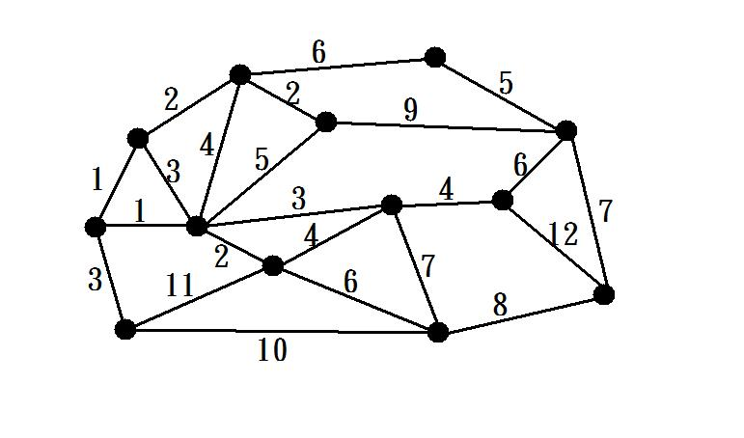
Exercise -3
Apply kruskal’s, prim’s algorithm to find a min spanning tree with min cost

Slide 38
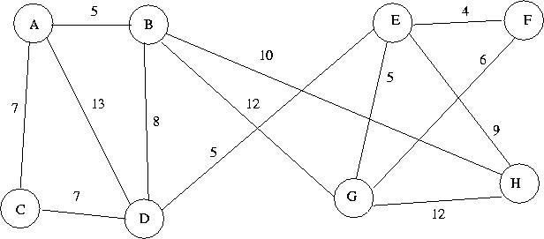
Exercise -3

Slide 39
Huffman Coding - 4

Slide 40
Huffman Coding
Huffman codes can be used to compress information
Like WinZip – although WinZip doesn’t use the Huffman algorithm
JPEGs do use Huffman as part of their compression process
The basic idea is that instead of storing each character in a file as an 8-bit ASCII value, we will instead store the more frequently occurring characters using fewer bits and less frequently occurring characters using more bits
On average this should decrease the filesize (usually ½)

Slide 41
Huffman Coding
As an example, lets take the string:
“duke blue devils”
We first to a frequency count of the characters:
e:3, d:2, u:2, l:2, space:2, k:1, b:1, v:1, i:1, s:1
Next we use a Greedy algorithm to build up a Huffman Tree
We start with nodes for each character
e,3
d,2
u,2
l,2
sp,2
k,1
b,1
v,1
i,1
s,1

Slide 42
Huffman Coding
We then pick the nodes with the smallest frequency and combine them together to form a new node
The selection of these nodes is the Greedy part
The two selected nodes are removed from the set, but replace by the combined node
This continues until we have only 1 node left in the set

Slide 43
Huffman Coding
e,3
d,2
u,2
l,2
sp,2
k,1
b,1
v,1
i,1
s,1

Slide 44
Huffman Coding
e,3
d,2
u,2
l,2
sp,2
k,1
b,1
v,1
2
i,1
s,1

Slide 45
Huffman Coding
e,3
d,2
u,2
l,2
sp,2
k,1
2
2
b,1
v,1
i,1
s,1

Slide 46
Huffman Coding
e,3
d,2
u,2
l,2
sp,2
3
2
k,1
2
i,1
s,1
b,1
v,1

Slide 47
Huffman Coding
e,3
d,2
u,2
4
3
2
l,2
sp,2
k,1
2
i,1
s,1
b,1
v,1

Slide 48
Huffman Coding
e,3
4
4
3
2
d,2
u,2
l,2
sp,2
k,1
2
i,1
s,1
b,1
v,1

Slide 49
Huffman Coding
e,3
4
4
5
d,2
u,2
l,2
sp,2
2
3
i,1
s,1
k,1
2
b,1
v,1

Slide 50
Huffman Coding
7
4
5
e,3
4
l,2
sp,2
2
3
d,2
u,2
i,1
s,1
k,1
2
b,1
v,1

Slide 51
Huffman Coding
7
9
e,3
4
4
5
d,2
u,2
l,2
sp,2
2
3
i,1
s,1
k,1
2
b,1
v,1

Slide 52
Huffman Coding
16
7
9
e,3
4
4
5
d,2
u,2
l,2
sp,2
2
3
i,1
s,1
k,1
2
b,1
v,1

Slide 53
Huffman Coding
Now we assign codes to the tree by placing a 0 on every left branch and a 1 on every right branch
A traversal of the tree from root to leaf give the Huffman code for that particular leaf character
Note that no code is the prefix of another code

Slide 54
Huffman Coding
e | 00
d | 010
u | 011
l | 100
sp | 101
i | 1100
s | 1101
k | 1110
b | 11110
v | 11111
16
0
1
7
9
0
1
0
1
e,3
4
4
5
0
1
0
1
0
1
d,2
u,2
l,2
sp,2
2
3
0
1
0
1
i,1
s,1
k,1
2
0
1
b,1
v,1

Slide 55
Huffman Coding
These codes are then used to encode the string
Thus, “duke blue devils” turns into:
010 011 1110 00 101 11110 100 011 00 101 010 00 11111 1100 100 1101
When grouped into 8-bit bytes:
01001111 10001011 11101000 11001010 10001111 11100100 1101xxxx
Thus it takes 7 bytes of space compared to 16 characters * 1 byte/char = 16 bytes uncompressed

Slide 56
Huffman Coding
Uncompressing works by reading in the file bit by bit
Start at the root of the tree
If a 0 is read, head left
If a 1 is read, head right
When a leaf is reached decode that character and start over again at the root of the tree
Thus, we need to save Huffman table information as a header in the compressed file
Doesn’t add a significant amount of size to the file for large files (which are the ones you want to compress anyway)
Or we could use a fixed universal set of codes/freqencies

Slide 57
Single source shortest path-5
The shortest distance from a single vertex (source) to a destination is found.
It is also called as Dijkstra’s algorithm
It is assumed all the distances are positive.
It does not work on negative values.

Slide 58
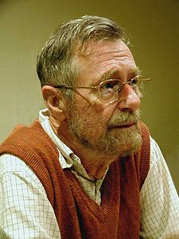
Edsger Wybe Dijkstra
"Computer Science is no more about computers than astronomy is about telescopes."

Slide 59
Edsger Wybe Dijkstra
- May 11, 1930 – August 6, 2002
- Received the 1972 A. M. Turing Award, widely considered the most prestigious award in computer science.
- The Schlumberger Centennial Chair of Computer Sciences at The University of Texas at Austin from 1984 until 2000
- Made a strong case against use of the GOTO statement in programming languages and helped lead to its deprecation.
- Known for his many essays on programming.

Slide 60
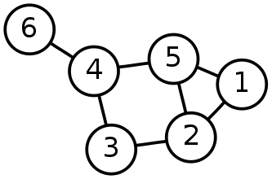
Single-Source Shortest Path Problem
Single-Source Shortest Path Problem - The problem of finding shortest paths from a source vertex v to all other vertices in the graph.

Slide 61
Dijkstra's algorithm
Dijkstra's algorithm - is a solution to the single-source shortest path problem in graph theory.
Works on both directed and undirected graphs. However, all edges must have nonnegative weights.
Approach: Greedy
Input: Weighted graph G={E,V} and source vertex v∈V, such that all edge weights are nonnegative
Output: Lengths of shortest paths (or the shortest paths themselves) from a given source vertex v∈V to all other vertices

Slide 62
Dijkstra's algorithm - Pseudocode
dist[s] ←0 (distance to source vertex is zero) for all v ∈ V–{s} do dist[v] ←∞ (set all other distances to infinity) S←∅ (S, the set of visited vertices is initially empty) Q←V (Q, the queue initially contains all vertices) while Q ≠∅ (while the queue is not empty) do u ← mindistance(Q,dist) (select the element of Q with the min. distance) S←S∪{u} (add u to list of visited vertices) for all v ∈ neighbors[u] do if dist[v] > dist[u] + w(u, v) (if new shortest path found) then d[v] ←d[u] + w(u, v) (set new value of shortest path)
(if desired, add traceback code)
return dist

Slide 63
Implementations and Running Times
The simplest implementation is to store vertices in an array or linked list. This will produce a running time of
O(|V|^2 + |E|)

Slide 64
Dijkstra's Algorithm - Why use it?
As mentioned, Dijkstra’s algorithm calculates the shortest path to every vertex.
However, it is about as computationally expensive to calculate the shortest path from vertex u to every vertex using Dijkstra’s as it is to calculate the shortest path to some particular vertex v.
Therefore, anytime we want to know the optimal path to some other vertex from a determined origin, we can use Dijkstra’s algorithm.

Slide 65
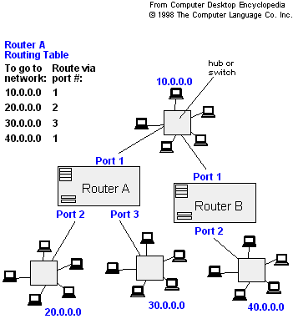
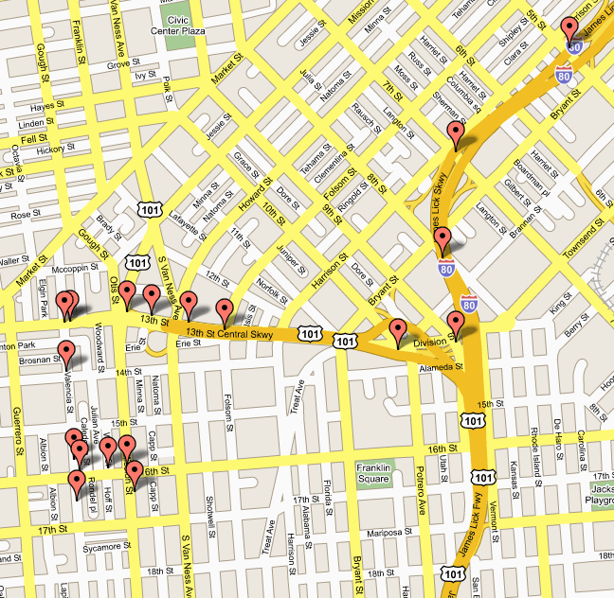
Applications of Dijkstra's Algorithm
- Traffic Information Systems are most prominent use
- Mapping (Map Quest, Google Maps)
- Routing Systems

